Slide 1
CS 578 Medical Image Analysis Final Project “Interactive Segmentation using Graph Cuts”
Ravindra Gadde Instructor:Dr.Tim McGraw
Raghu Kiran Yalamanchili

Slide 2
Outline:
Introduction
Approach and Implementation Details
Results
Other Implementations
References

Slide 3
Introduction:
In this project, we implemented Interactive Segmentation using graph cut based on the paper Yuri Boykov Marie –Pierre Jolly “Interactive Graph Cuts for Optimal Boundary & Region Segmentation of Objects in N-D Images”.
Here Interactive segmentation involves imposing both Hard Constraints (Indicate the pixels of the object region and the background region by the user) and soft constraints (Boundary and region properties of the segments).
Implemented algorithm is tested on both the Synthetic medical images (Brain MRI) and Non-medical images. The effect of adding noise to the original image on the actual segmentation is studied. This approach is compared with the other advanced techniques such as Grab cut, Lazy snapping, and Grow cut.

Slide 4

Approach and Implementation Details:
Initially Graph G = {V, E} is formed by nodes V and edges E. Along with consideration the Pixels of the image as nodes ,two additional nodes S(source) for object and T (Terminal) for the background are considered.
To convert Image in to weighted graph 4-neighbourhood system is considered. As mentioned in the paper, for each pair of nodes an edge is formed called n-link. The weight function that is assigned for each n-link (Bp,q )is given below.
Bp,q is a measure of the similarity of image intensities at pixels p and q.
$Bp,q=cexp\left(−\frac{\left(Ip−Iq\right)2}{2σ2}\right)1/dist(p,q)$.

Slide 5
To incorporate user supplied initialization, a set of pixels in foreground (object) and Background are selected.
Weights to the edges of the graph are assigned according to the algorithm specified in the Yuri Boykov paper.
The initialized regions are used to define the histograms for the region based segmentation. Here negative log likelihood’s are used to define the weights
Rp(“obj”)=-ln Pr(Ip\O);
Rp(“bkg”)=-ln Pr(Ip\B);
Here Pr(Ip\O),Pr(Ip\B) are the intensities of histograms of object and background respectively. The other implementation details are mostly derived from the paper.

Slide 6
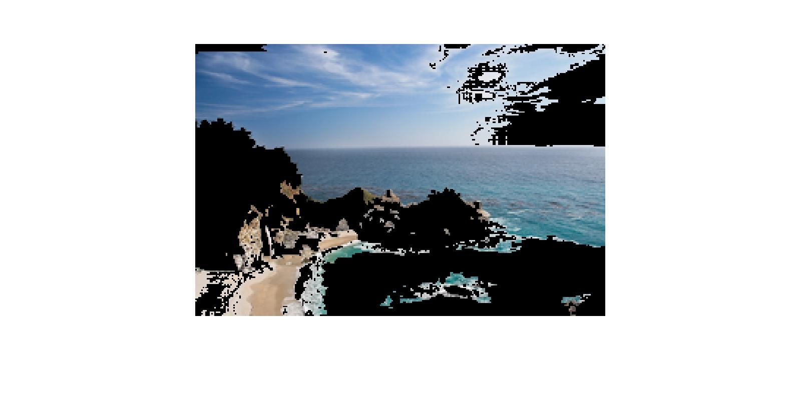

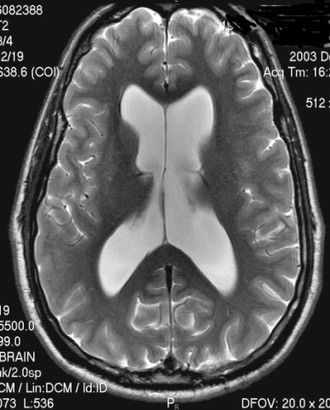
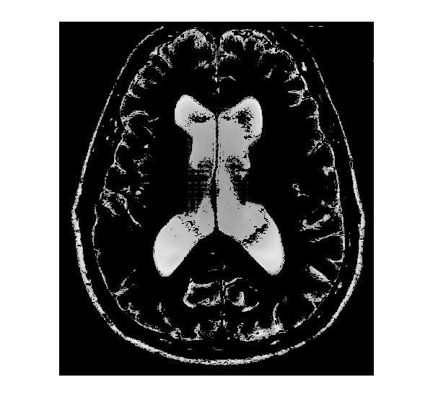
Results:
Beach Image
Original Image
Segmented Background Output image after the interactive initialization of foreground and Background
Brain MRI image
Original Image
Segmented Foreground image using Yuri Algorithm

Slide 7
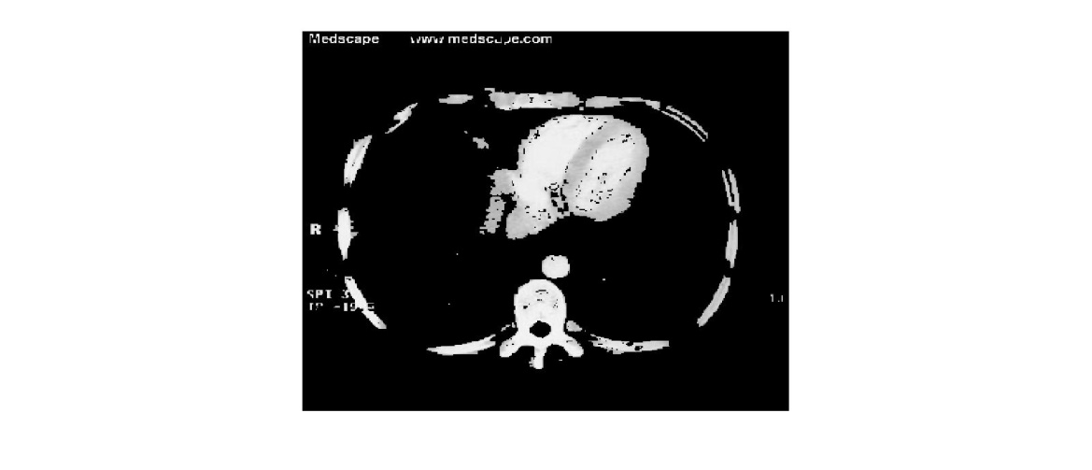
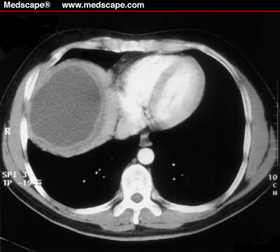
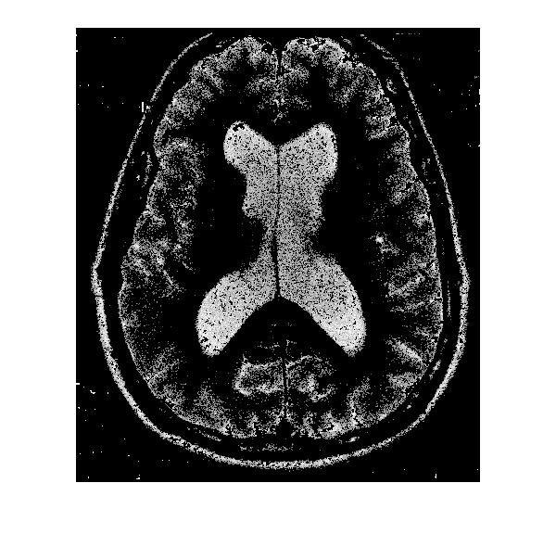
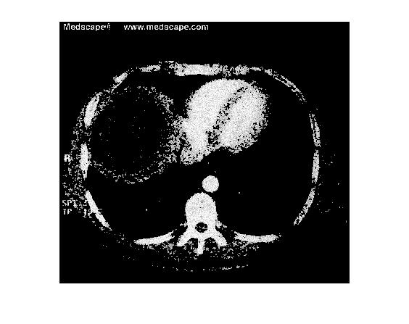
Results Contd.,
Abdomen Image
Original Image
Segmented Foreground image using Yuri Algorithm
Segmented Brain MRI image with noise
Segmented Abdomen image with noise

Slide 8
Other Implementations:
There are advanced segmentation algorithms in the literature which extends the concepts of graph cuts. Prominent of them are
Grab Cut: Grab Cuts extends graph-cut by introducing iterative segmentation scheme that uses graph-cut for intermediate steps.
Lazy Snapping: Lazy snapping is an interactive image cut out tool. Lazy Snapping separates coarse and fine scale processing, making object specification and detailed adjustment easy.
Grow Cut: Given a small number of user-labeled pixels, the rest of the image is segmented automatically by a Cellular Automaton. The process is iterative.

Slide 9
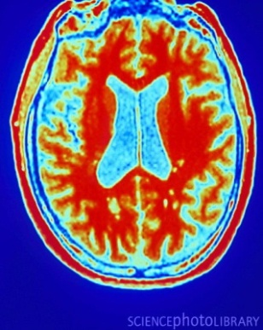
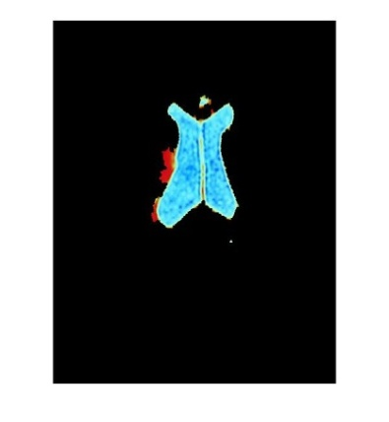

Original Image
Segmented image using Grab cut
Segmented image using Grab cut + lazy snapping

Slide 10
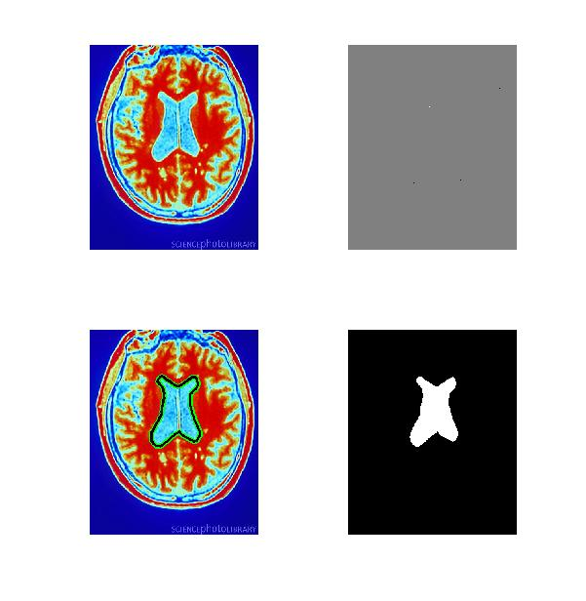
Original Image
Seeds
Segmented Image represented with boundary
Segmented Image

Slide 11
References:
Y.Boykov,M.P Jolly, Interactive Graph Cuts for Optimal Boundary & Region Segmentation of Objects in N-D Images,ICCV 2001.
Rother et.,al “Grab Cut” — Interactive Foreground Extraction using Iterated Graph Cuts,2004
Y.Li et.,al lazy Snapping,SIGGRAPH,2004
Vladimir Vezhnevets et.,al.,“Grow Cut” - Interactive Multi-Label N-D Image Segmentation By Cellular Automata.
M.Gupta et.al,“ Segmentation tool”,CMU.

